Slide 1

AI driven development
Github Copilot

Slide 2
What is GitHub Copilot?
Tool to write easier and faster code
Powered by GPT-3
Generative Pre-trained Transformer 3 (GPT-3)
Large language model released by OpenAI in 2020

Slide 3
General idea
Write a description of what you need
Copilot will create for you

Slide 4

Get Copilot as a student
Go to https://education.github.com/benefits
Use your student email to register
Still need to wait 2-3 days to be activated

Slide 5
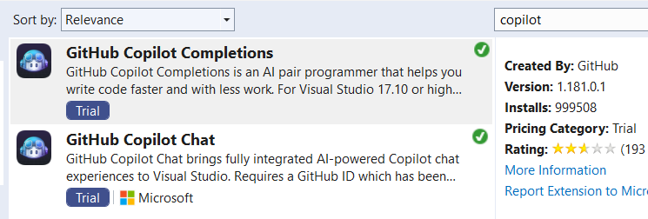
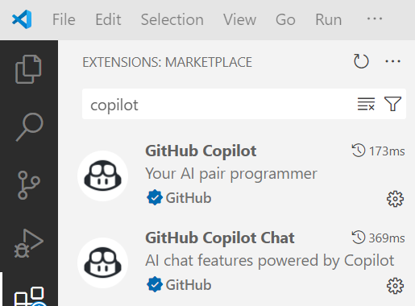
Extensions to install
Visual Studio
VS Code
Login using your Github account

Slide 6
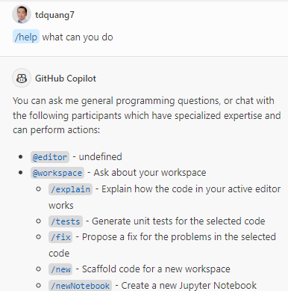
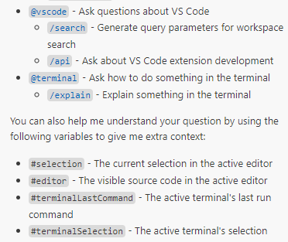
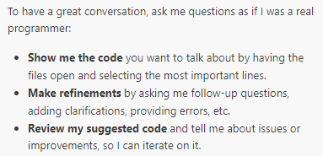
Ask Copilot for help instructions

Slide 7
Code generation

Slide 8
Two ways to use Copilot to generate code
Manually write description in comment
Automatically suggest code as you write

Slide 9
Generate a class Fraction
Write comment: “//class Fraction” > Enter

Slide 10
Code explaination

Slide 11
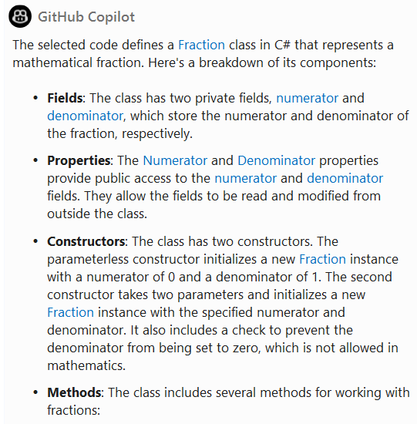
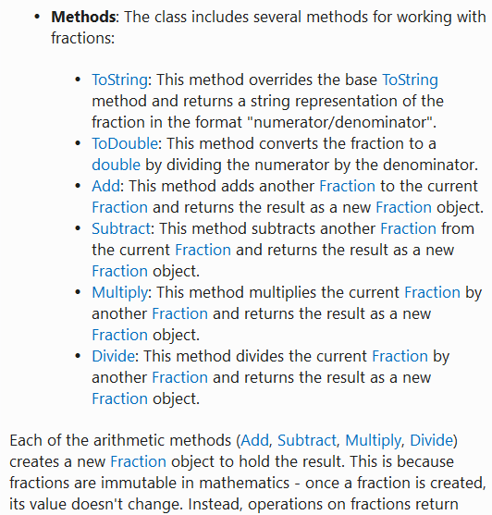
Ask Copilot to explain the code for you /explain

Slide 12
Create documentation

Slide 13
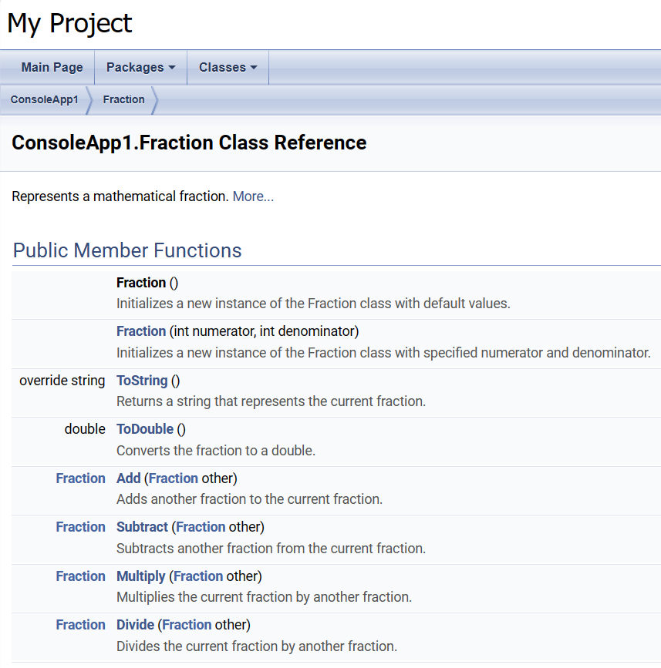
Ask Copilot to generate documentation: /doc
Preview then accept
Use doxygen to create
documentation

Slide 14
Code improvement

Slide 15
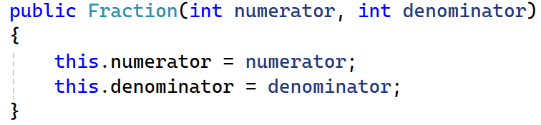
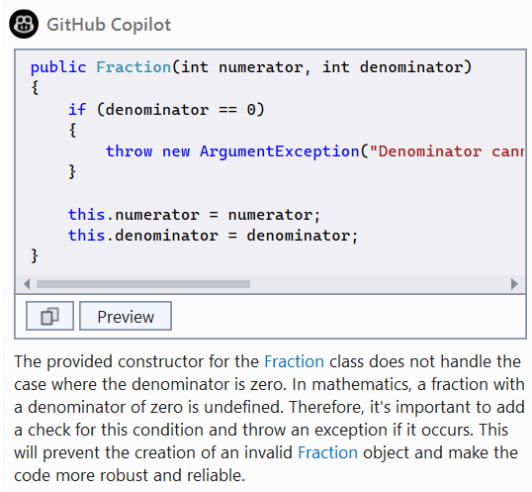
Ask Copilot to improve your code /optimize
To apply the change, click
Preview > Accept

Slide 16
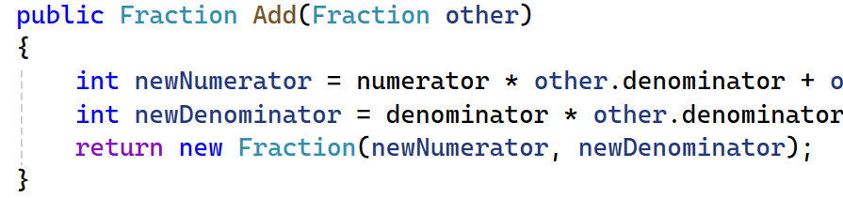
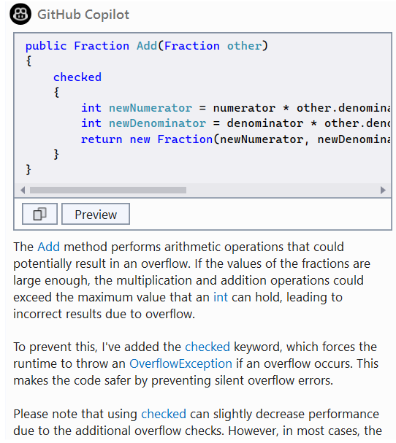
Other example of /optimize

Slide 17
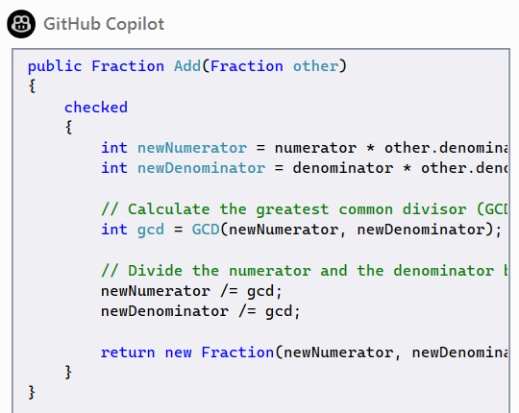
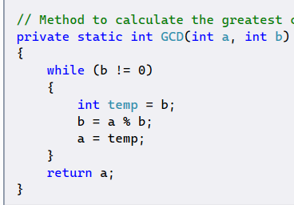
What if we want to improve more?
“Improve the selected function to return a reduced fraction using greatest common divisor”

Slide 18
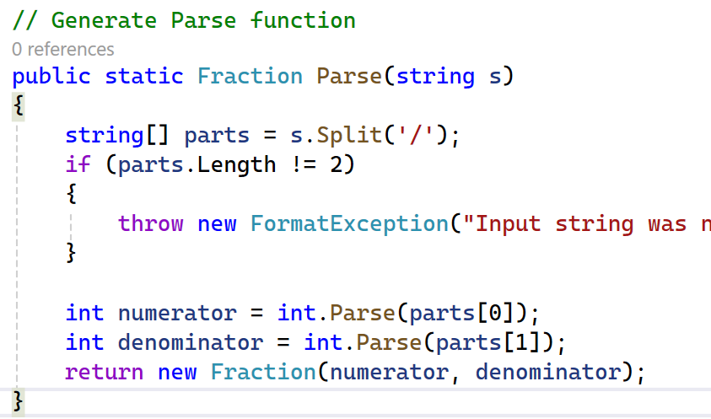
Let’s ask Copilot to add a Parse function

Slide 19
How about
Explain the code for us?
Adding comments to create documentation?
Could we improve / optimize the code more?
How can our teammate be sure that our code is good?
=> Unit test

Slide 20
Test generation

Slide 21
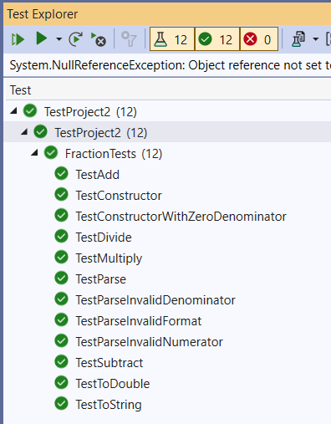
Generate unit tests with /tests
Create MSTest Test project
Copy&Paste the generated code
Add project reference
Problem? Naming convention not good

Slide 22
Asking Copilot to fix it
Function naming convention should be:
UnitOfWork_StateUnderTest_ExpectedBehavior
Prompt: “Improve the name of all the functions using the naming standard UnitOfWork_StateUnderTest_ExpectedBehavior”

Slide 23
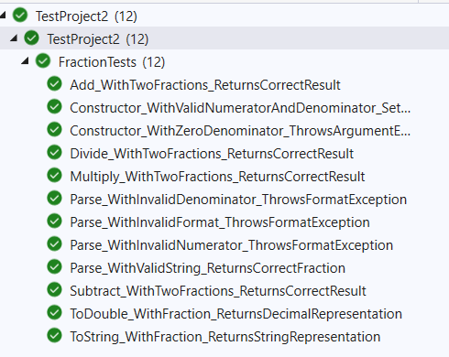
Better result

Slide 24
Fixing bugs

Slide 25
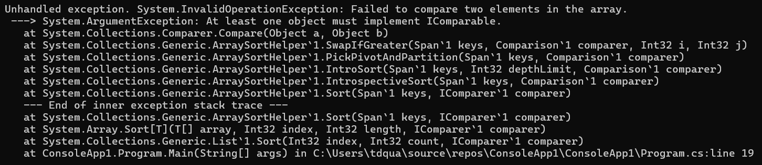
In the main function
// Generate randomly 20 fractions into a list
// Sort the list of fractions
// Print out all the fractions

Slide 26
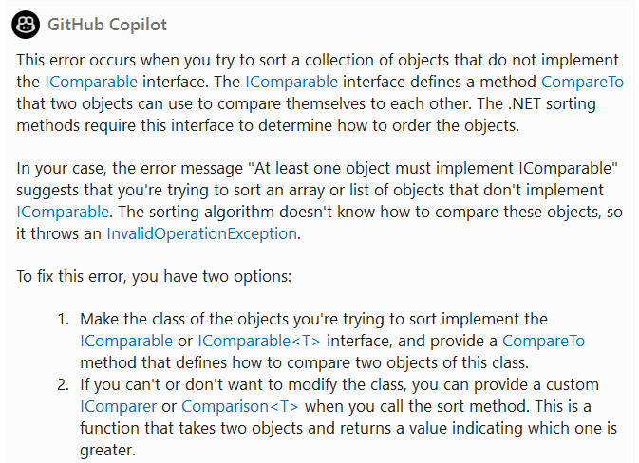
Ask Copilot to explain the error

Slide 27
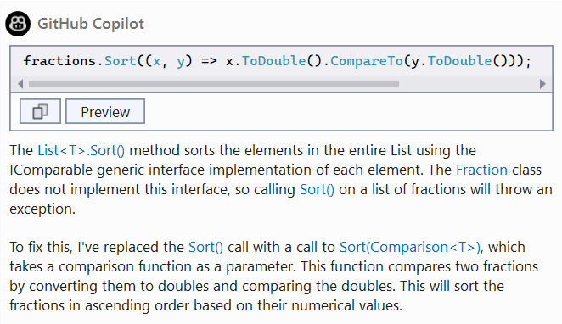
Ask Copilot to fix the error /fix

Slide 28
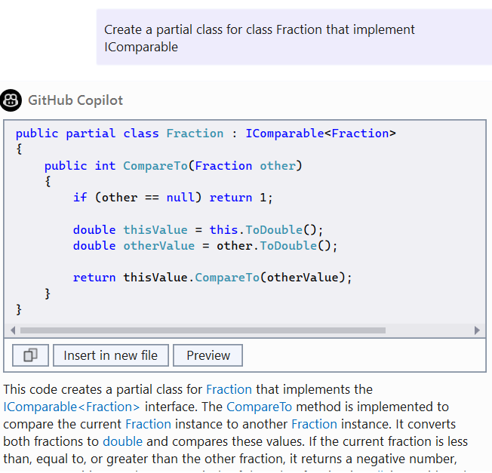
Alternative to improve

Slide 29
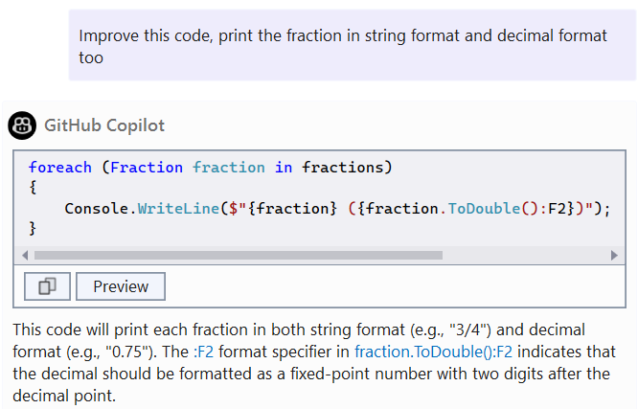
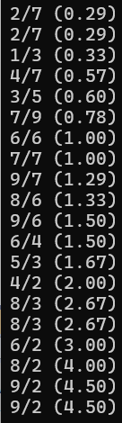
Further improvement

Slide 30
Some other tips

Slide 31
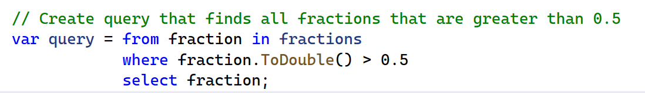
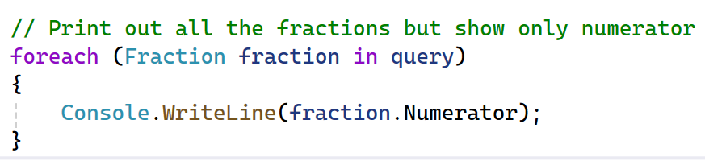
Other things

Slide 32
Translate your comment

Slide 33
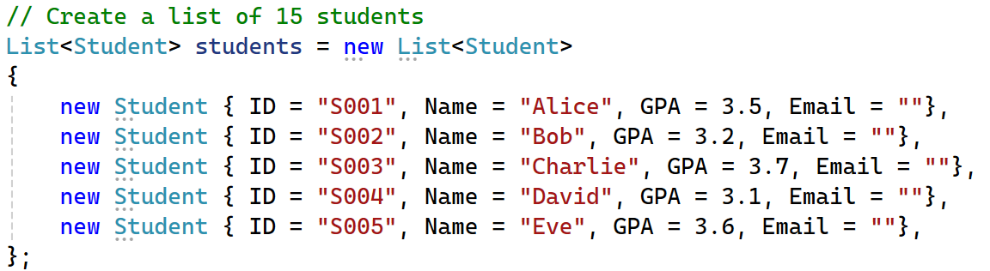
Quickly prepared sample data

Slide 34
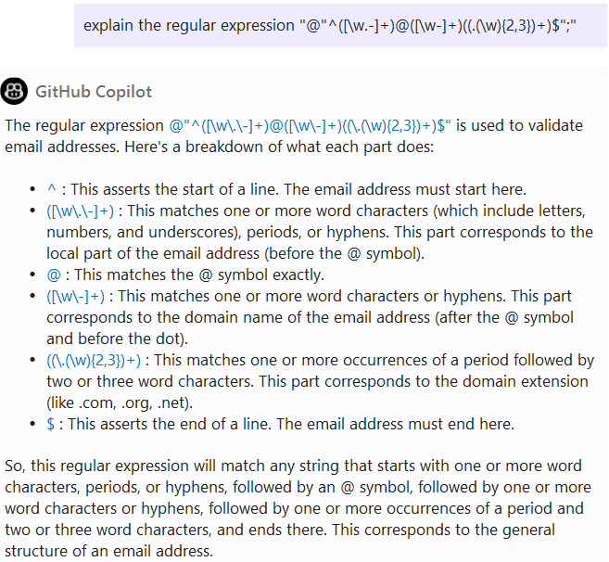
Quick reminder of regular expression

Slide 35
Converting to another language
Try translate & explain
For example
Write a function to calculate the sum of an integer array in C#.
Convert this function into python

Slide 36
Database schema & data creation
Generate the script to create the tables and foreign keys:
Table: User, Fields and Types: id auto, firstName text(50), lastName text(50), email text(50), password text(20)
Table: Project, Fields and Types: id auto, name text(50)
Table: ExpenseType, Fields and Types: id auto, name text(50)
Table: Expense, Fields and Types: id auto, description text(100), idExpenseType numeric, idProject numeric, idUser numeric, date date
Generate the script to fill with sample data those tables: 5 Users, 3 Projects, 4 ExpenseTypes
Generate 30 Expenses with random combination for users, projects and expenseTypes, with dates between November 15 and December 15, 2022

Slide 37
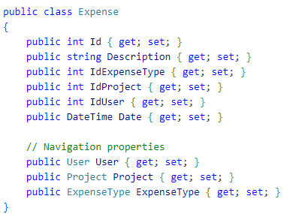
What about models / entities from the database?
Prompt: Create the C# classes to map those tables

Slide 38
What should we notice?
The AI is aware of the flow of the conversation and previous generated code.
It can continue to work on the chat history
Context window

Slide 39
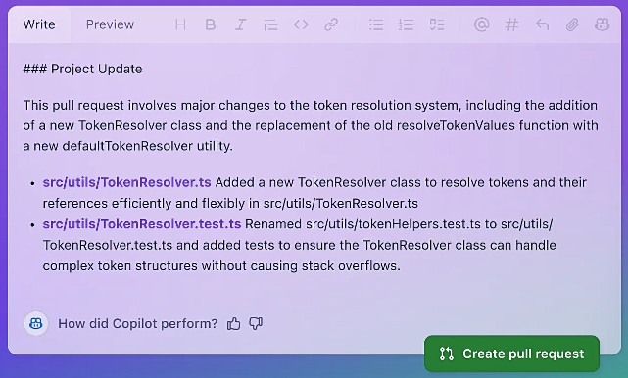
Pull request suggestions

Slide 40
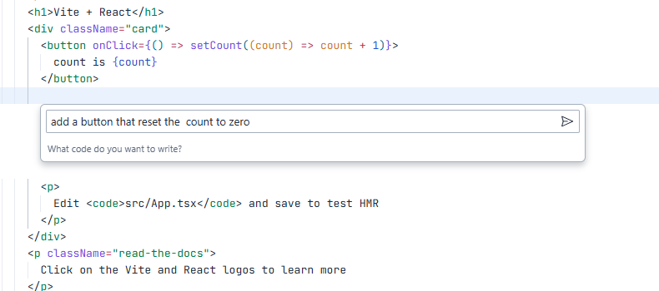
IDX + Gemini
Activate: Ctrl + Shift + Space
Inline code help: Ctrl + I
Get code help with Gemini | Project IDX | Google for Developers

Slide 41
Some pros & cons

Slide 42
Benefits & Drawbacks (1)
Benefits | Drawbacks
Increased efficiency and productivity AI-driven development tools can automate repetitive and time-consuming tasks, such as code generation and testing, allowing developers to focus on more complex and higher-value work. | High initial costs Implementing AI-driven development tools and processes can be costly in terms of both time and money. However, subscription models such as Copilot can solve the issue for developers.

Slide 43
Benefits & Drawbacks (2)
Benefits | Drawbacks
Improved code quality AI-driven development tools can analyze code and identify potential bugs or errors, helping to improve the overall quality of the code. | Limited capabilities AI-driven development tools are still in the early stages of development and may not be able to handle all aspects of the software development process.

Slide 44
Benefits & Drawbacks (3)
Benefits | Drawbacks
Enhanced scalability AI-driven development tools can help identify and address scalability issues early on in the development process, allowing for the creation of more robust and scalable software. | Dependence on data AI-driven development tools rely on data to function, which can be a problem if the data is not accurate or of high quality.

Slide 45
Benefits & Drawbacks (4)
Benefits | Drawbacks
Faster time to market By automating certain tasks, AI-driven development can help to speed up the overall development process, allowing for faster deployment and time-to-market. | Lack of transparency Some of the decisions made by AI-driven development tools can be difficult to understand or explain, which can be a problem if stakeholders need to understand the reasoning behind certain decisions.

Slide 46
Benefits & Drawbacks (5)
Benefits | Drawbacks
Better collaboration AI-driven development tools can help bridge communication gaps between developers, stakeholders, and customers, leading to better collaboration and more efficient decision-making | Job Losses As AI-driven development automates repetitive and time-consuming tasks, some less skilled jobs may become redundant, leading to job losses

Slide 47
Further reading

Slide 48
What’s more
10 Best AI Chatbots for Coding in 2025?
Strategy for prompt engineering
https://microsoft.github.io/prompt-engineering

Slide 49
Related - Better Prompts
Awesome prompts
https://github.com/f/awesome-chatgpt-prompts

Slide 50
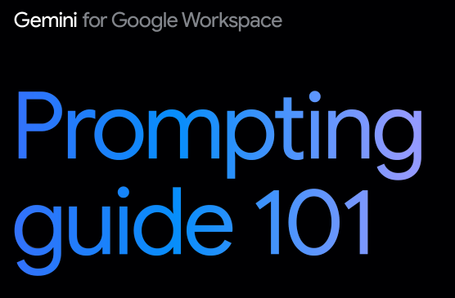
Gemini prompting guide 101

